Slide 1
Next Hikes IT Solutions Project 2: DATA HARMONIZATION AND INSIGHTS EXTRACTION
Name:- Nivedita Rajguru

Slide 2
Using library pandas, matplotlib.pyplot, NumPy and seaborn impoart data
in python and visualize.
Using info():The.info() method provides a concise summary of the DataFrame, including:
. info(): Gives you a quick overview of the DataFrame’s structure and data types.
The number of entries (rows)
The number of columns
The names of the columns
The data types of each column
Memory usage

Slide 3
3. Using .head() The .head() method returns the first five rows of the DataFrame,
which is useful for quickly inspecting the data.
.head(): Allows you to preview the first few records, helping you understand the content and format of your data.
4. Using isnull().sum() method is commonly used in pandas to check for missing values in a DataFrame.
5. Using duplicated().sum() method in pandas is used to identify and count the number of duplicate rows in a DataFrame.
6. Using pd.merge() function in pandas is used to combine two DataFrames based on a common key or column.
7. Using fillna(method='bfill') method in pandas is used to fill missing values (NaN) in a DataFrame by backfilling. This means that for any missing value, the next valid value from the DataFrame will be used to fill it

Slide 4
8. Using pd.concat() function in pandas is used to concatenate two or more DataFrames along a particular axis. In your example, you're concatenating data1_and_2 and dataset3 vertically (along rows) and resetting the index.
[data1_and_2, dataset3]: This is a list of DataFrames to concatenate.
axis=0: This specifies that you want to concatenate along rows (vertical concatenation). Use axis=1 for horizontal concatenation (adding columns).
ignore_index=True: This resets the index in the resulting DataFrame, so it has a continuous index from 0 to n-1
9. Using .drop() unnecessary columns or duplicates from a DataFrame in pandas, you can use a combination of the drop() and duplicated() methods.
Use drop(): You can specify the columns you want to remove.
Use drop_duplicates(): This method removes duplicate rows from the DataFrame.

Slide 5
· Dropping Columns: Use drop(columns=[...]) to remove any columns that are not needed.
· Removing Duplicates: Use drop_duplicates() to ensure each row in the DataFrame is unique.
10. Using df.to_csv('merged_file.csv', index=False) is used to save a pandas DataFrame to a CSV file.
Code Explanation
df: This is your DataFrame that you want to save as a CSV file.
to_csv(): This method is used to write the DataFrame to a CSV file.
'merged_file.csv': This is the name of the file where the DataFrame will be saved. You can specify a full path if you want to save it to a specific directory.
index=False: This parameter indicates that you do not want to write row indices to the CSV file. If set to True, the DataFrame's index will be included as an additional column in the CSV.

Slide 6
Data Visualize using key : boxplots, subplot and distplot for data figure.
Creating visualizations like boxplots, subplots, and distribution plots (distplots) can help you understand your data better.
Boxplots
A boxplot (or whisker plot) displays the distribution of data based on a five-number summary: minimum, first quartile (Q1), median, third quartile (Q3), and maximum. It’s useful for identifying outliers.
Subplots
Subplots allow you to display multiple plots in one figure. You can specify the number of rows and columns for the layout.
Distribution Plots (Distplot)
distplot has been deprecated in recent versions of Seaborn. Instead, you can use histplot and kdeplot to visualize the distribution of your data.

Slide 7
Summary
Boxplots are great for comparing distributions and spotting outliers.
Subplots allow for multiple visualizations in one figure.
Distribution plots help you visualize the density of your data.
Weather:
1. Maximum ride and hr in spring weather.
2. Average ride and hr in summer weather.
3. Minimum ride and hr in fall weather.
4. Loeast ride and hr in winter weather.

Slide 8
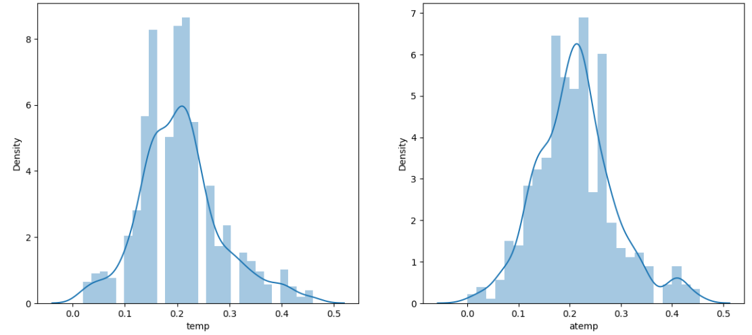
Subplot and distplot temp and atemp

Slide 9
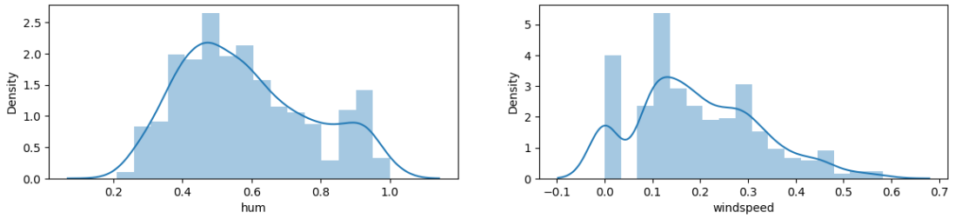
Subplot and distplot windspeed and hum

Slide 10
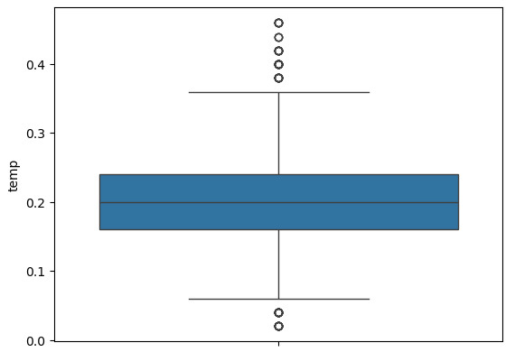
Boxplot temp

Slide 11
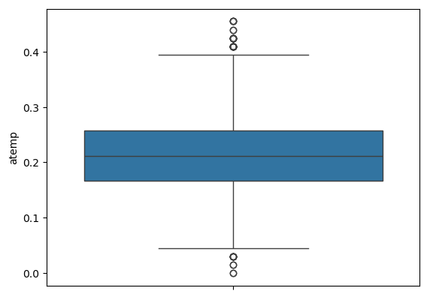
Boxplot atemp

Slide 12
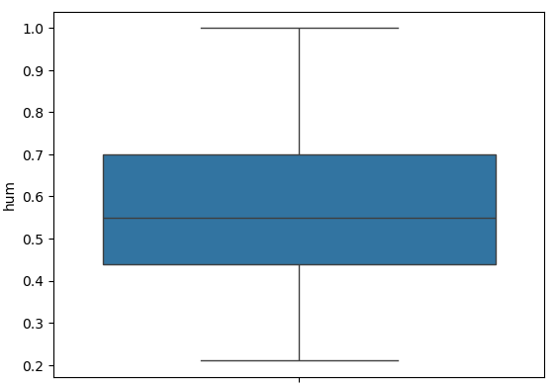
Boxplot hum

Slide 13
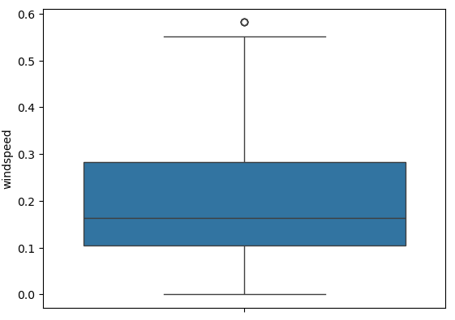
boxplots windspeed

Slide 14
THANK YOU

